Slide 1
What Impacts will Gender Stereotypes Have on Children?
Presented by Yang Zhongheng, Wang Kaiqi

Slide 2
Gender stereotypes about intellectual ability emerge early and influence children’s interests
by Lin Bian, Sarah-Jane Leslie, and Andrei Cimpian
What Impacts will Gender Stereotypes Have on Children?
Presented by Yang Zhongheng, Wang Kaiqi
Science
Volume 355(6323):389-391
January 27, 2017

Slide 3
Question
High-level cognitive ability is presented more
often in men than in women.
However, little is known about the acquisition
of this stereotype.
brilliance
males

Slide 4
Data
Four studies:
N = 400 children, mostly from a middle-class, majority-white U.S.
 | Study 1 | Study 2 | Study 3 | Study 4
Question | Assess children’s endorsement of the “brilliant = male” stereotype. | What might explain the drop in girls’ evaluation of their gender’s intellectual abilities? | Will children’s gendered beliefs about brilliance shape their interests? | Will aged-5 boys’ and girls’ interest in these games would not differ because their ideas about brilliance are not yet differentiated?
Comparison | Aged 5 vs 6 vs 7 between boys and girls. | Younger(5) and older (6 or 7) girls in their perceptions of their school achievement. | Aged 6 and 7 were introduced into 2 games, one said to be for “smart children”, the other for “children who try really, really hard.” | 5- and 6-year-old boys’ and girls’ interest in novel games said to be “for children who are really, really smart”

Slide 5
Data
Four studies:
N = 400 children, mostly from a middle-class, majority-white U.S.
 | Study 1 | Study 2 | Study 3 | Study 4
Question | Assess children’s endorsement of the “brilliant = male” stereotype. | What might explain the drop in girls’ evaluation of their gender’s intellectual abilities? | Will children’s gendered beliefs about brilliance shape their interests? | Will aged-5 boys’ and girls’ interest in these games would not differ because their ideas about brilliance are not yet differentiated?
Comparison | Aged 5 vs 6 vs 7 between boys and girls. | Younger(5) and older (6 or 7) girls in their perceptions of their school achievement. | Aged 6 and 7 were introduced into 2 games, one said to be for “smart children”, the other for “children who try really, really hard.” | 5- and 6-year-old boys’ and girls’ interest in novel games said to be “for children who are really, really smart”
Conclusion | Children’s idea about brilliant exhibit rapid changes over the period from ages 5 to 7. | Girls’ ideas about who is brilliant are not rooted in their perceptions of who performs well in school. | Young children’s emerging notions about who is likely to be brilliant are one of the factors that guide their decisions about which activities to pursue. | There are no significant gender differences in interest among 5-year-olds

Slide 6
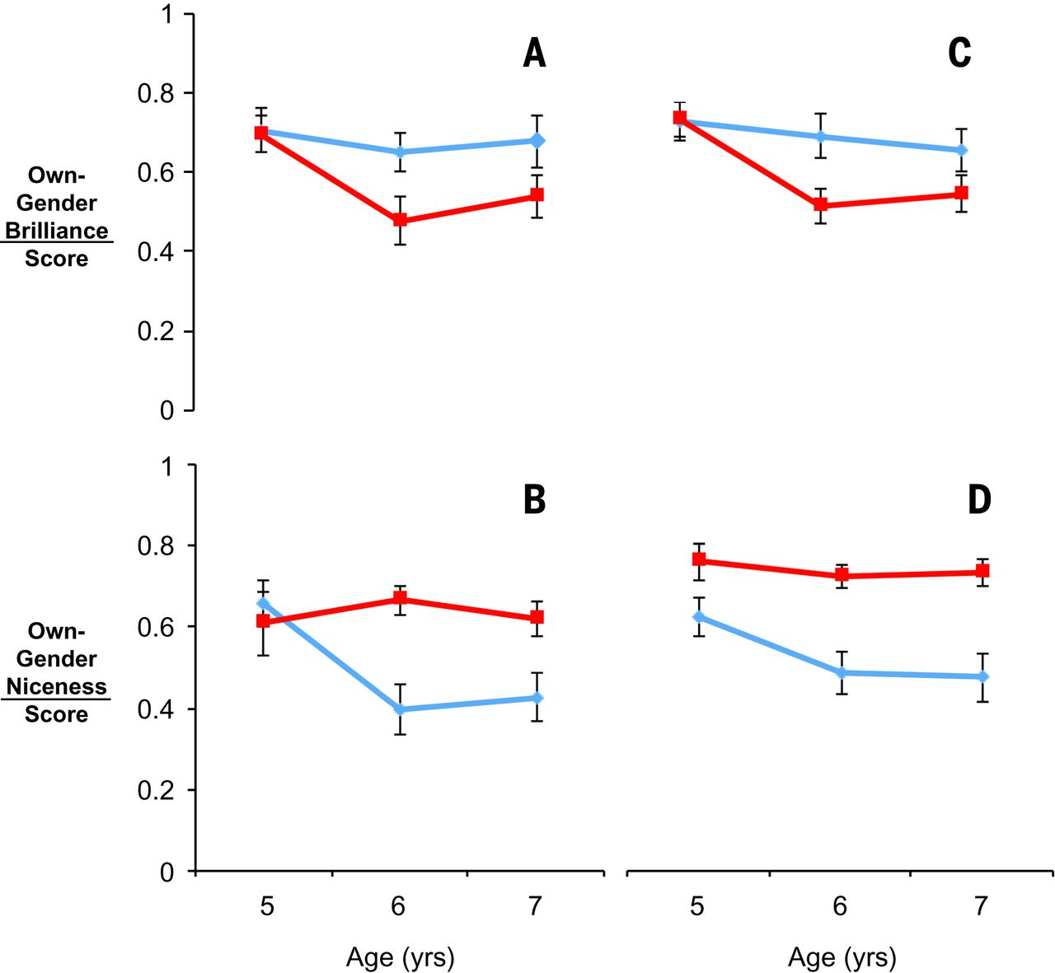
Results of Study 1
Fig. 1A & Fig. 1C
Notes:
Results of studies one and two. Boys’ (blue) and girls’ (red) stereotype scores in study one (A and B) and study two (C and D), by age group (5- versus 6- versus 7-year-olds). Error bars represent ± 1 SE.

Slide 7
Fig. 1 Results of studies one and two.
Notes:
Results of studies one and two. Boys’ (blue) and girls’ (red) stereotype scores in study one (A and B) and study two (C and D), by age group (5- versus 6- versus 7-year-olds). Error bars represent ± 1 SE.

Slide 8
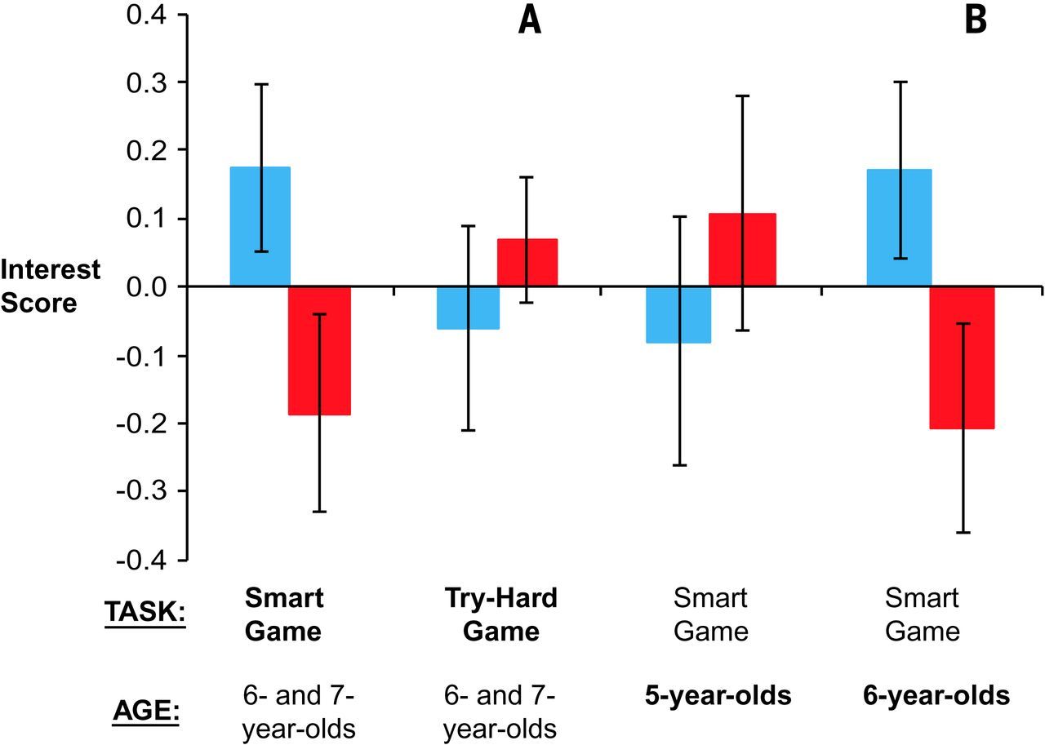
Fig. 2 Results of studies three and four.
Notes:
Results of studies three and four. Boys’ (blue) and girls’ (red) interest (average of standardized responses to four questions) in novel games in study three (A) and study four (B). The main independent variable for each study (task in study three, age in study four) is shown in bold. Error bars represent ± 1 SE.

Slide 9
Answer
1.By the age of 6, girls are less likely than boys to believe that members of their gender are “really, really smart.”
2.Also at 6, girls begin to avoid activities said to be for children who are “really, really smart.”
3.It suggests that gendered notions of brilliance are acquired early and have an immediate effect on children’s interests.

Slide 10
Conclusion
Many children approve of the idea that brilliance is a male quality at a young age.
This stereotype begins to shape children’s interests as soon as it is acquired.
Thus, it is likely to narrow the range of careers they will one day contemplate.

Slide 11
What can we do?
For individual:
1. Keep confident.
2. Follow your heart, not others.
For society:
1. Keep everyone equal.
2. Attribute one’s brilliance to his efforts and willpower, instead of gender.
brilliance
males
brilliance
efforts

